Slide 1
Keyboard redraft notes

Slide 2
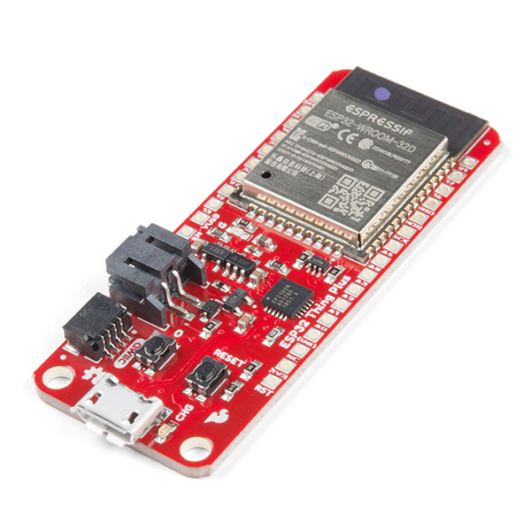
Viajero
Ordered various sensors, including thing plus ESP32
Allows for super low latency broadcast direct wireless connections
NREAL headset on it’s way now
Plan would be
One ESP32 broadcaster with car sensors (OBD, IMU, GNSS)
One ESP32 receiver on/near headset, with it’s own head IMU
That receiver then communicates (over serial port? Wifi direct? Ble?) with headset/platform
Gives us a (mostly) wireless platform, easily reproducible, and relatively stand alone (e.g. no laptops required)
This assumes the magnetometer for preventing drift approach works for 3DoF

Slide 3
Existing structure
Augmented Keyboard
Takes keyboard definition, builds shortcut locations
Augmented Keyboard Map Manager
Tracks which KeyboardMaps are active
KeyboardMap
Collection of shortcuts
Shortcut
This is everything to do with the actual UIElement basically – where it’s assigned, where you wanted to assign it to etc.

Slide 4
Refactoring
Shortcuts -> KUIElement
ScriptableObject
ShortcutLocation -> KUIElementLocation
These keep track of which shortcut is active/visible

Slide 5
Paper argument would be…
Here’s a reference design for the platform
All sensors required, pretty much headset agnostic for 3DoF headsets
Here’s demonstrations of what it enables people to do
VR
Some kind of motion experiences
AR
Some kind of location-based experiences
Here’s some datasets you can use to test/build experiences out
Discussion of what’s needed for next steps
E.g. 6DoF – ZED unity lib not updated yet
But… Sept 17 deadline – 6 weeks remaining(!)

Slide 6
Keyboard refactor
We build a layout from either 3d model or KLE
We use this layout and build an instance of the keyboard
A collection of XR Interactables with basic display options (mesh)
We have an XRInteractionManager that specifically can trigger activations based on key input – it looks through current interactables and will trigger appropriate actions that way
UILayoutElement – use this to construct UIElementContainers
UIElementContainer – this is the old shortcut container, dictating which UI element is visible, and giving them access to instances of e.g. the mesh we can display on
UIElementCollection – this is our additive mapping of shortcuts as before
UIElement – this is our “key” shortcut. If active. Either gets events from XR Interaction Manager, or it’s container, whichever makes the most sense
Each UIElement can have triggers and visualizations that act upon XR interactor events
AugmentedKeyboard – manages the active UIElementContainers and which UIElements are active, as before.
Then support creating UIElementCollection from imported Microsoft keyboard mapping – quick way to create multiple keyboard layouts for e.g. switching languages
Then support UIElements that span multiple existing UILayoutElements
Merged mesh vertices, then create one polygonal mesh that fits
Have these support the same set of interactions
For gestures, have gestures based on the magnitude of the movement if possible, and demonstrate with e.g. swipe to change keyboard layout

Slide 7
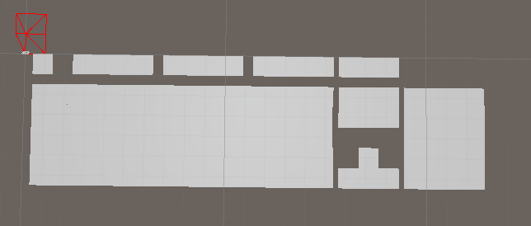
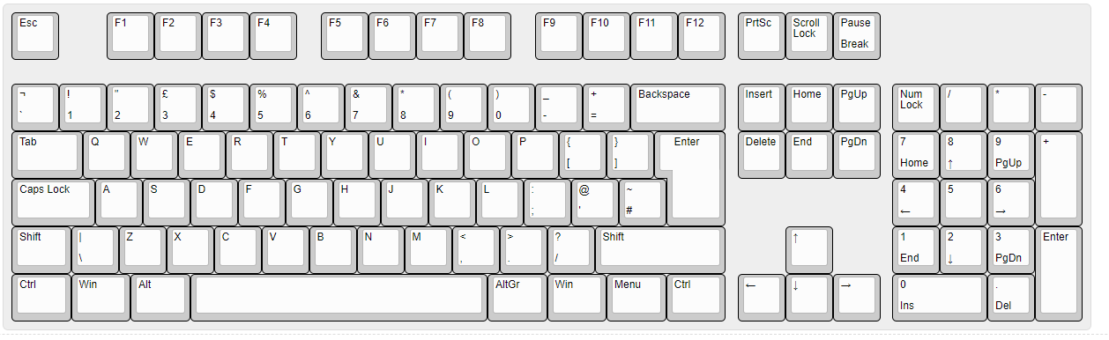

Slide 8
End results?
Can generate virtual keyboard layout
Optionally – can use it for soft keyboards too – expands toolkit applicability e.g. demo an augmented keyboard which detaches from the physical keyboard when you stand up
Can import existing keyboard mappings (non-hierarchical, but it’s a start)
Can define hierarchies of mappings with flexible visualizations and triggers
Can have keys react to custom events (e.g. hover) and even generic XR events (e.g. raycast)

Slide 9
Design
Flow of control should be:
Virtual mapping (layout, actions, hierarchies etc.)
Physical layout (key positions – for augmented keyboard this relates to the physical positions; for soft keyboard this is the desired soft keyboard layout)
Features / controls
Key augmentations
Icons / Text labels
Call-out labels
3D augmentations
Key colouring
Keyboard + augmentation show/hide
Per-key trigger states
Multi-key shortcuts

Slide 10
Keyboard stack
The keyboard stuff is very messy at platform/standards level. It typically has (somewhere in the stack/app) a conversion from USB HID codes (device) to Virtual Key Codes (app) ... There is a function MapVirtualKeyA ... but have not messed around with that stuff for a long long time!
In fact our keyboard folks (but not me!) still use/experiment with Microsoft Keyboard Layout Creator App
Mostly they are modifying existing templates, and they more often do a quick visual check here
Form Factor: This is good reference for the physical layouts ... major ones being ANSI ISO JIS
In our VR experiments we're making models for ANSI and JIS and the user selects manually ... so the right enter key is shown!
In theory, the USB Vendor ID and Product ID could tell you the make/model ... and you could get the form factor from that ... and pull an associated model from cloud?

Slide 11
Keyboard layout
Have three built in layouts
ANSI, ISO, JIS
Optionally, provide ability to specify a parser that builds a layout from a supplied 3D model
Layout specifies order and breaks of keys per row
All key sizes are specified in units, breaks appear custom to make it fit

